Slide 1
House Data Analysis
Source: https://www.kaggle.com/datasets/harishkumardatalab/housing-price-prediction
Dataset: Housing dataset
Email: valasalaashwikanjani@gmail.com

Slide 2
Introduction:
This presentation provides an analysis of the Office Employees data, covering:
Structure and Uniqueness
Furnishing Distribution
Location Representation
Price Insights
Area & Size Distribution
Additional Features
Overall Housing Characteristics

Slide 3
Initial Analysis of the Dataset
The dataset provided contains details of 545 houses across different locations and furnishing categories. It has 13 columns, including price, area, bedrooms, bathrooms, stories, and multiple features such as air conditioning, guestroom, basement, and parking availability. Categorical fields like mainroad, prefarea, and furnishingstatus enrich the dataset by capturing lifestyle and location-driven factors. There are no missing values, ensuring data consistency and completeness, which is an advantage for any analysis. Below are the detailed insights:
Structure and Uniqueness
The dataset comprises 545 rows and 13 columns, each representing various characteristics of houses. Every row is a unique house entry, identified by attributes such as price, area, bedrooms, and facilities. Categorical variables like furnishing status (furnished, semi-furnished, unfurnished) and location-related features (main road, preferred area) ensure diversity in housing types. No missing values are present, which makes the dataset reliable for analysis.
2. Furnishing Distribution
The dataset captures three categories of furnishing status: furnished, semi-furnished, and unfurnished. Furnished houses dominate, followed by semi-furnished, while unfurnished houses make up the smallest share. This distribution highlights a market preference for ready-to-move-in properties, where convenience outweighs cost for many buyers.

Slide 4
Initial Analysis of the Dataset
3. Location Representation
Houses are characterized by location-linked attributes such as proximity to main roads and presence in a preferred residential area. A majority of properties have access to the main road, which indicates the importance of connectivity in housing prices. Preferred area properties are fewer but typically priced higher, showing the premium attached to location advantages.
4. Price Insights
House prices in the dataset range widely, from ₹17 lakh to over ₹1.33 crore. Most houses fall into the mid-range bracket, reflecting affordability trends in urban housing. Larger houses with premium amenities (air conditioning, parking spaces, preferred area) consistently fall into the higher price segment. The variation shows how location and facilities strongly influence pricing.
5. Area & Size Distribution
House sizes (measured in square feet of area) vary significantly, with some compact homes around 1,650 sq. ft., while larger properties extend beyond 16,000 sq. ft.. In terms of structure, most houses have 2 to 4 bedrooms, and the majority are 1–2 stories high, indicating a prevalence of medium-sized family homes in the dataset

Slide 5
Initial Analysis of the Dataset
6. Additional Features
Bonus-like features such as guest rooms, basements, hot water heating, and air conditioning differentiate houses beyond just size and price. While not universally present, these features tend to cluster in higher-priced houses. For example, air conditioning and guest rooms are more common in premium properties, reflecting lifestyle-driven demand.
7. Overall Housing Characteristics
The dataset portrays a diverse housing market where price is influenced not only by size but also by location and amenities. The majority of houses are medium-sized, well-connected to main roads, and furnished. Premium homes stand out by combining large areas with luxury add-ons like basements, air conditioning, and preferred area locations. This mix indicates a market catering to both mid-income buyers seeking affordability and high-income buyers pursuing exclusivity.

Slide 6
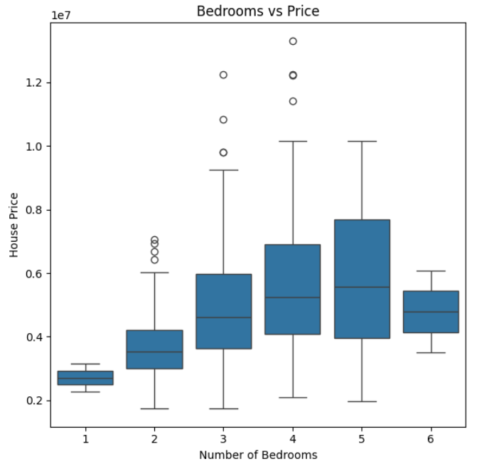
Bedrooms vs Price
Insight: This plot highlights how house prices vary across different numbers of bedrooms, helping identify trends such as whether larger houses generally cost more or if there are outliers with unusually high or low prices.

Slide 7
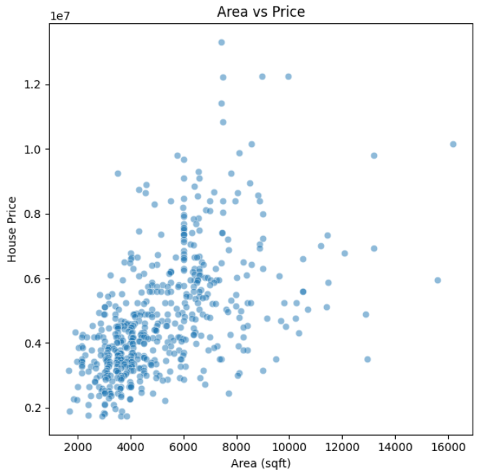
Area vs Price:
Insight: This plot highlights how house prices vary across different numbers of bedrooms, helping identify trends such as whether larger houses generally cost more or if there are outliers with unusually high or low prices.

Slide 8
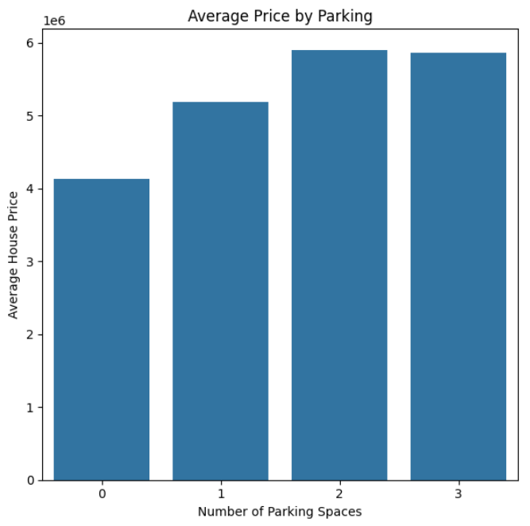
Average Price by Parking:
Insight: This bar plot highlights how the average house price changes with the number of stories, helping identify whether multi-story houses are generally more expensive.

Slide 9
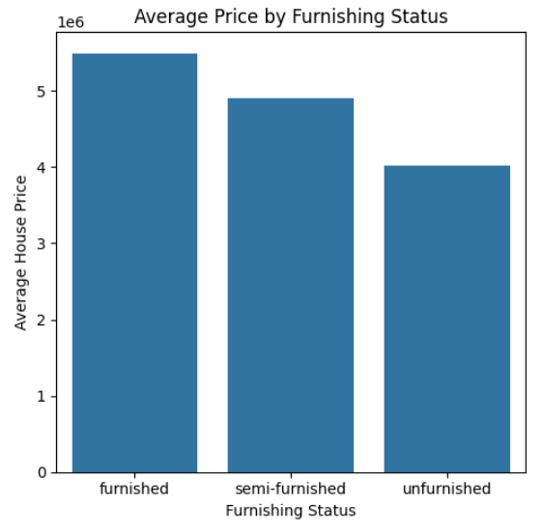
Average Price by Furnishing Status
Insight: It highlights whether furnished houses are priced higher than semi-furnished or unfurnished ones, helping buyers or investors understand market trends.

Slide 10
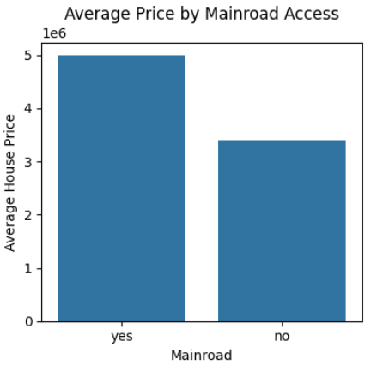
Average Price by Mainroad Access
Insight: This visual helps identify if proximity to main roads affects house prices. Typically, houses on main roads might have higher prices due to accessibility, which is crucial for investment or development planning.

Slide 11
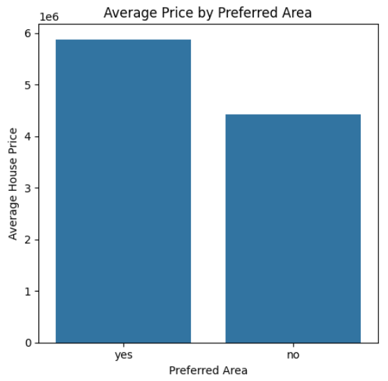
Average Price by Preferred Area:
Insight: This plot highlights whether having more parking spaces correlates with higher house prices, providing insight for buyers, developers, and urban planners.

Slide 12
Data Observation:
1. Bedrooms vs Price
Houses with more bedrooms generally tend to have higher prices, but there are outliers where smaller houses have very high prices.
3-4 bedrooms houses are the most common in the dataset.
The boxplot shows price variation within the same bedroom count, suggesting other factors like area or location also affect price.
2. Area vs Price
There is a positive correlation between house area and price: larger houses tend to be more expensive.
Most houses are concentrated in moderate area ranges, while very large houses are less common and can have very high prices (outliers).
Scatter points show some exceptions, likely due to additional features like furnishing or location.

Slide 13
Data Observation:
3. Stories vs Price
Houses with more stories (2 or 3) tend to have higher average prices than single-story houses.
Single-story houses are common and have a wider price range, indicating that some single-story houses can also be expensive.
Multi-story houses show consistent price increase, reflecting higher construction and space value.
4. Furnishing Status vs Price
Furnished houses are generally more expensive than semi-furnished or unfurnished houses.
Semi-furnished houses have moderate average prices, while unfurnished houses are the cheapest.
This shows that interior finishing significantly affects house pricing.

Slide 14
Data Observation:
5. Mainroad vs Price
Houses with access to the main road have slightly higher average prices compared to houses without main road access.
Mainroad access improves connectivity and convenience, making the property more desirable.
However, some non-mainroad houses are still expensive, indicating other influential factors like area or furnishing.
6. Parking vs Price
Houses with more parking spaces generally have higher prices.
Single parking space houses are most common.
More parking spots may indicate larger plots, luxury homes, or better infrastructure, which increases property value.

Slide 15
Conclusion:
The analysis of the house dataset reveals that house prices are influenced by multiple factors, primarily size, amenities, and location. Houses with more bedrooms, larger area, and multiple stories generally have higher prices, although outliers indicate that smaller houses can sometimes be expensive due to other factors. Amenities such as furnishing status, parking spaces, air-conditioning, hot water heating, and basements positively affect house prices, with furnished houses being the most expensive, followed by semi-furnished and unfurnished houses. Location also plays a significant role; houses with main road access or situated in preferred areas tend to be priced higher due to convenience and desirability. Overall, house pricing is multi-factorial, and a combination of size, amenities, and location determines the value of a property. Buyers, investors, and developers can use these insights to make informed decisions, identifying high-value properties and understanding the key factors driving price variations in the real estate market.

